Slide 1
Atomic
Mathematics

Slide 2
What is chemistry? Anybody know?
Atoms?

Slide 3
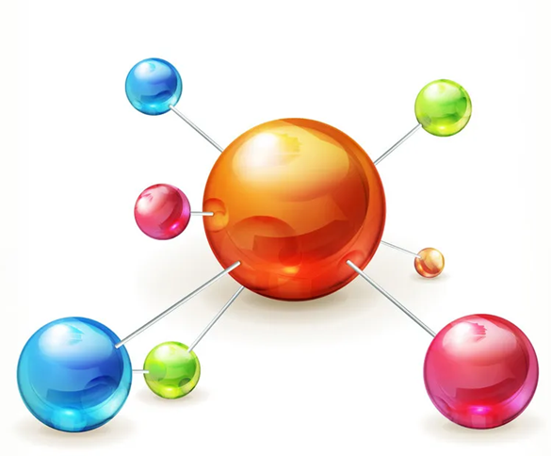

Slide 4
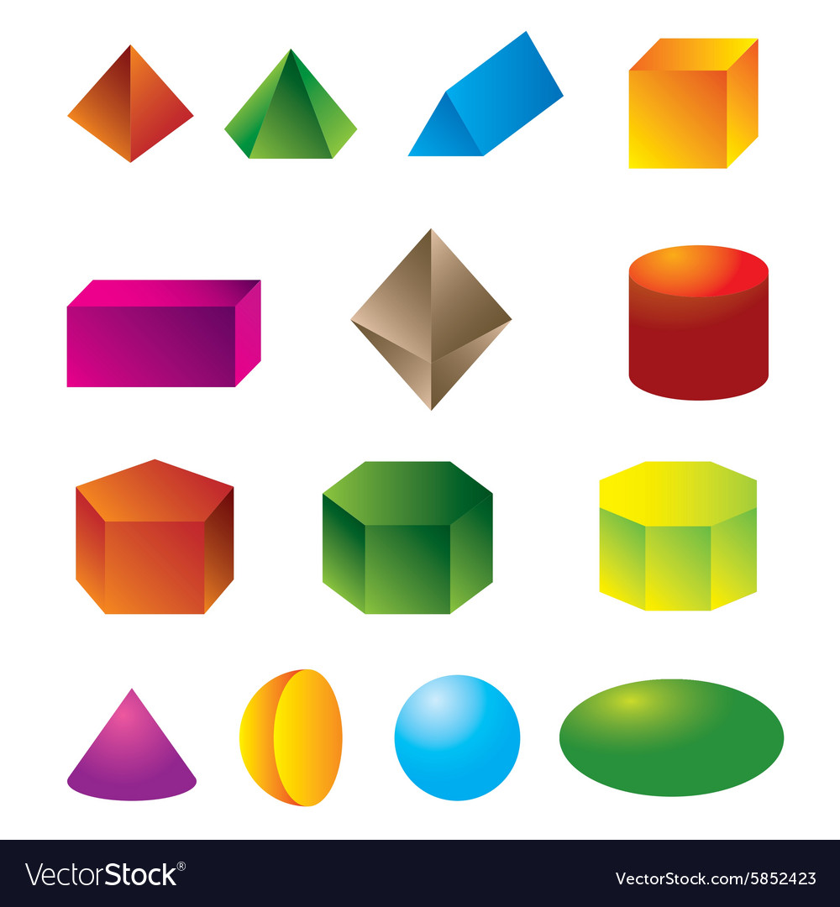

Which geometric shapes do you know?

Slide 5
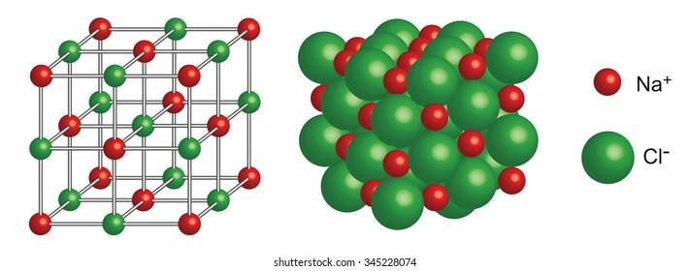
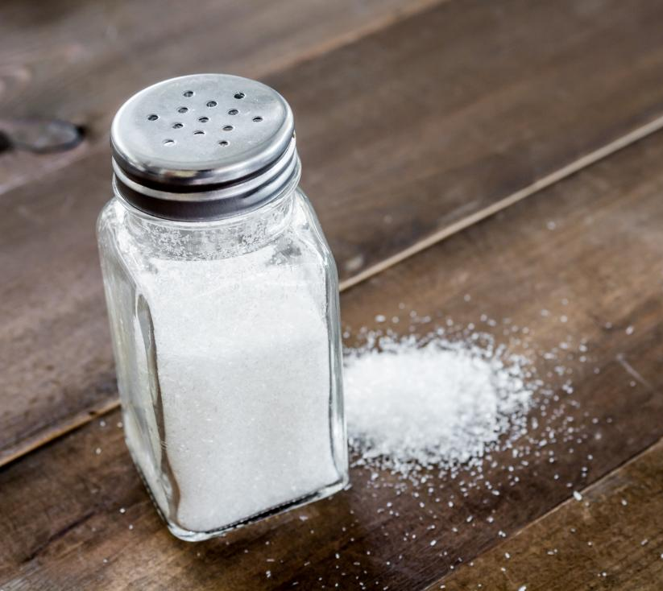
Salt under the microscope

Slide 6
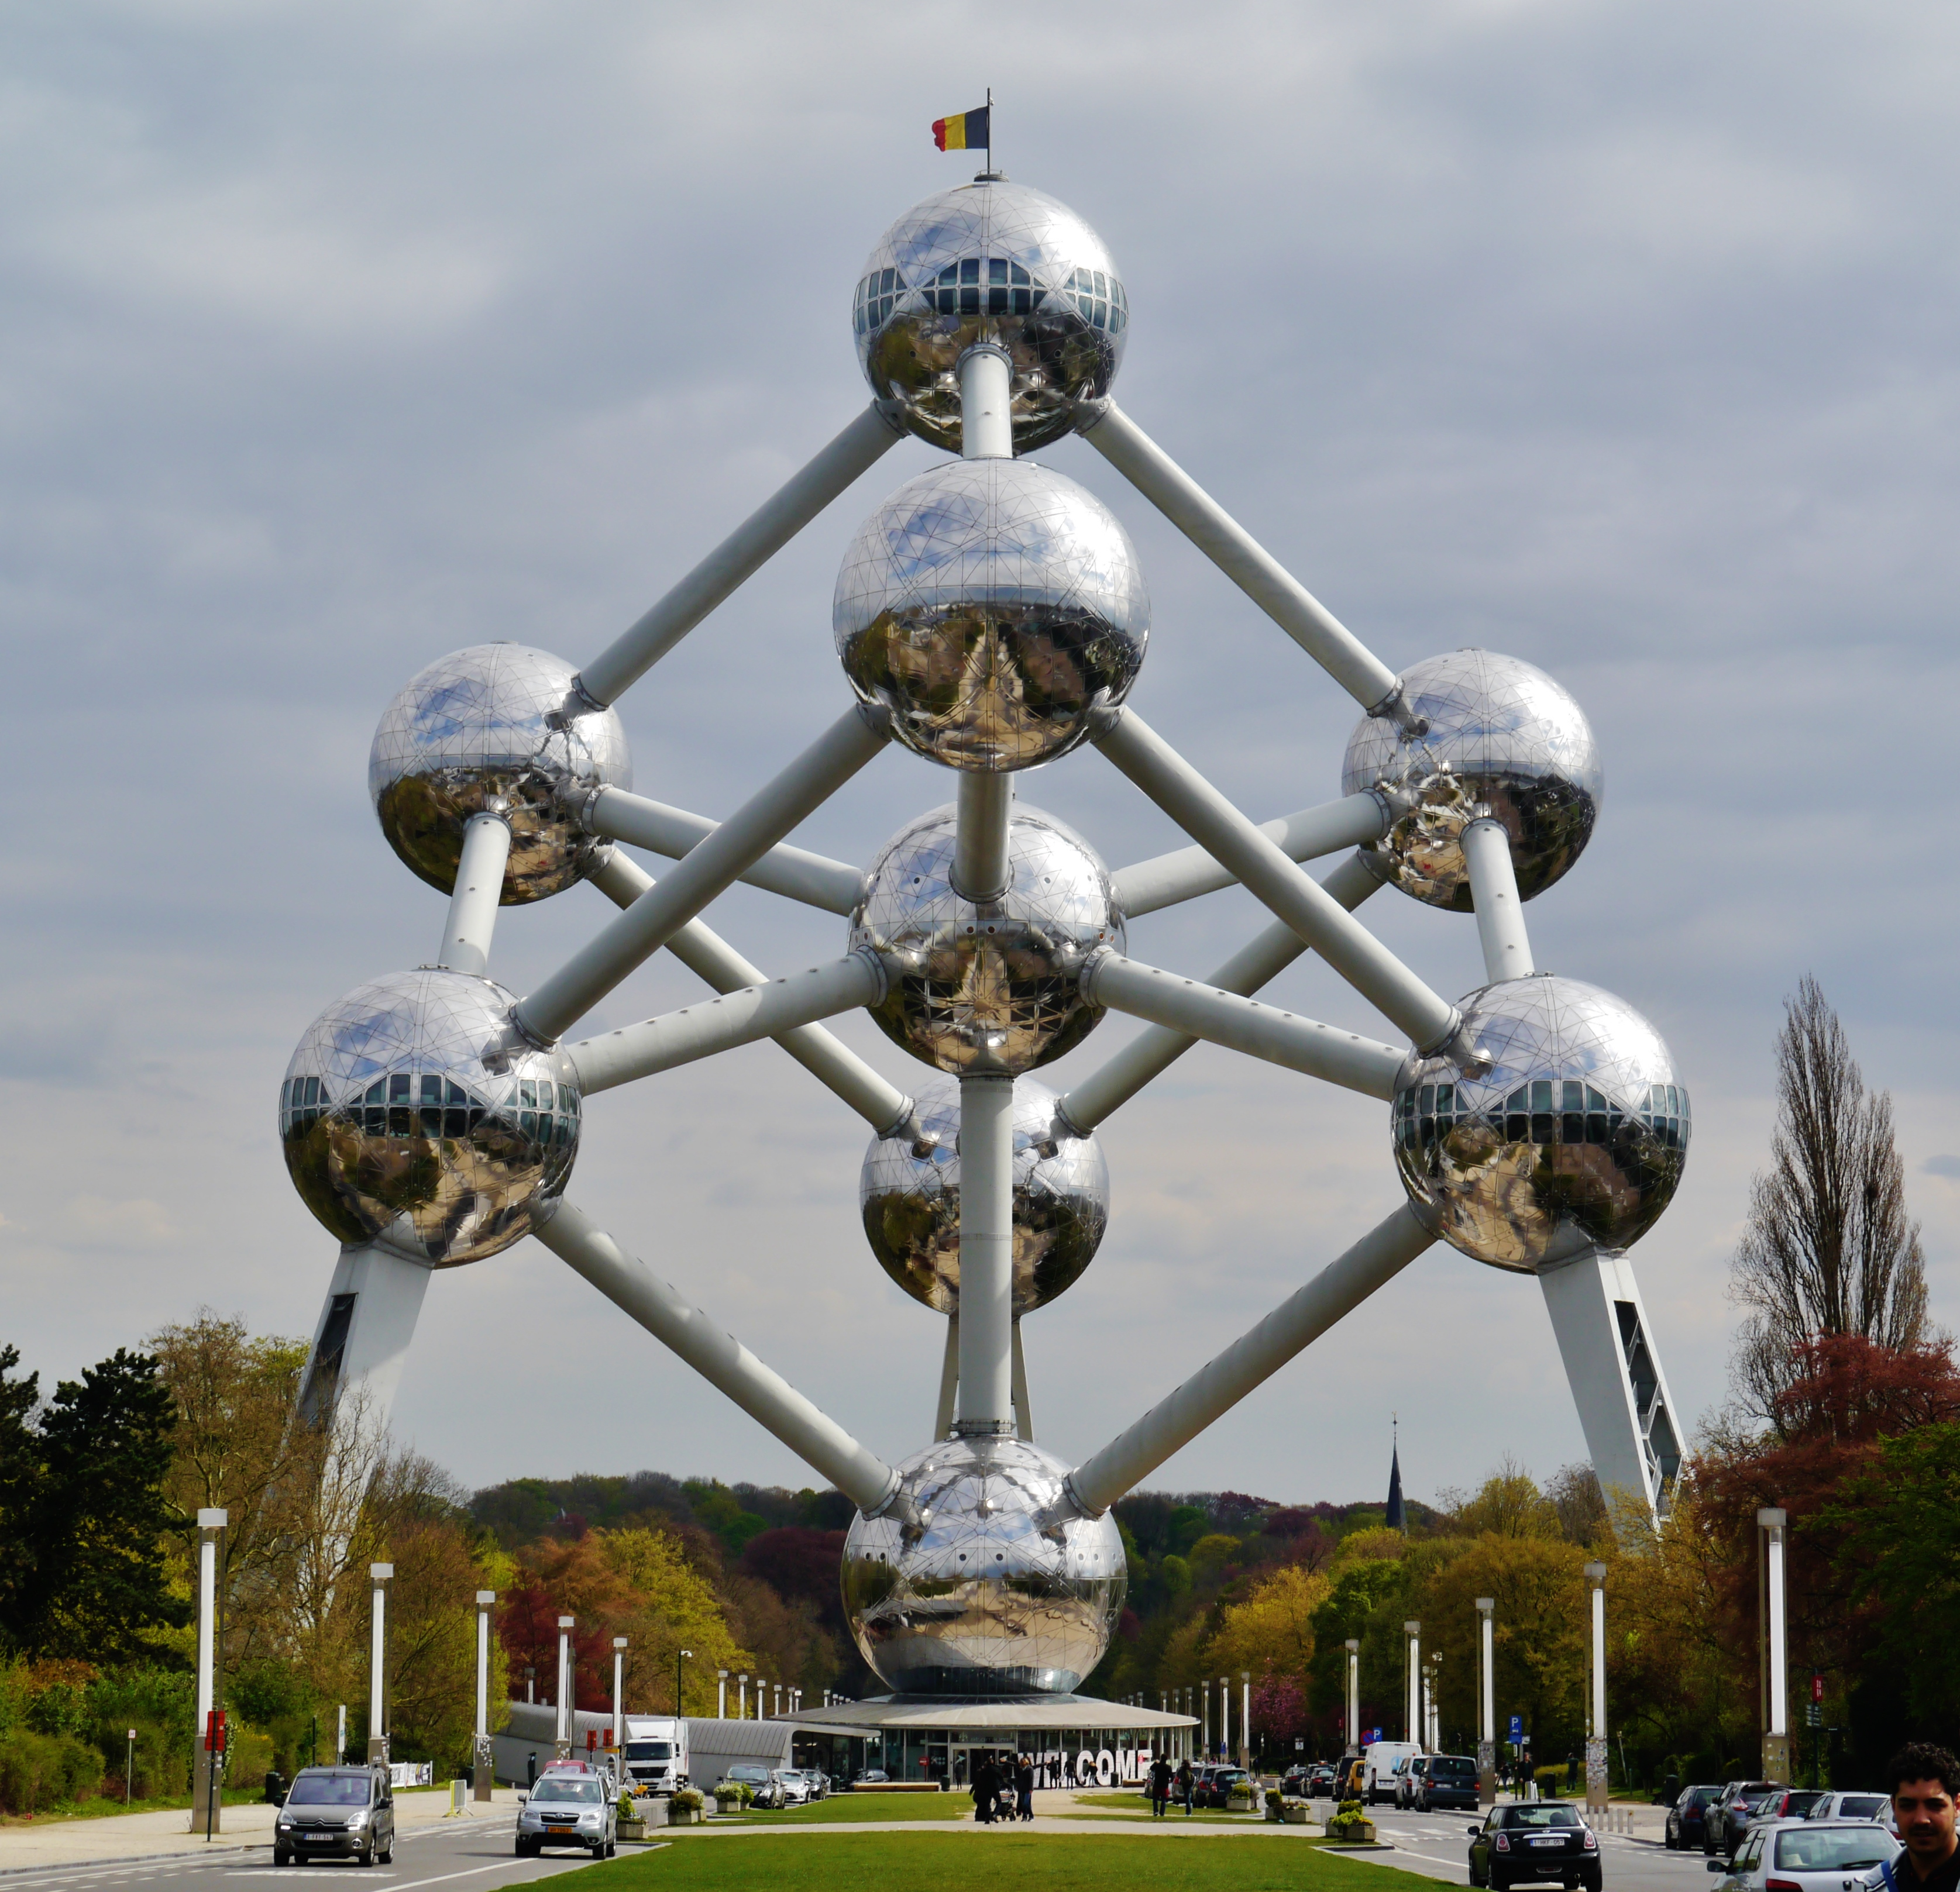
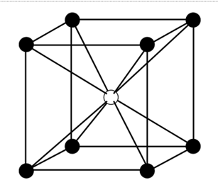
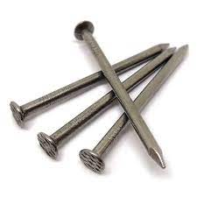
Nails under the microscope
Atomium building in Brussels

Slide 7
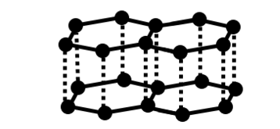
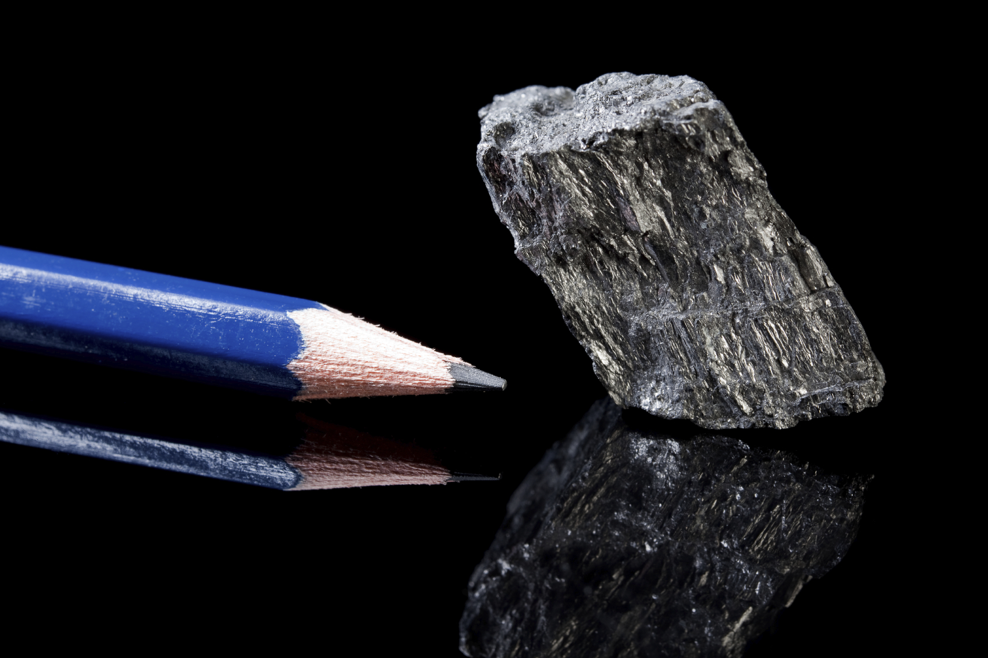
Pen under the microscope

Slide 8

Thank you!

