Slide 1
How long is a year?
The project An interdisciplinary approach to mathematical education (2020-1-HR01-KA201-077816) is co-founded by the Erasmus+ Programme of the European Union, Key Action: Cooperation for innovation and the exchange of good practices - Strategic Partnerships for school education.

Slide 2
Do you know?
What time is it now?
How we measure time?
What day of the week is today?
What time did you get up this morning?

Slide 3
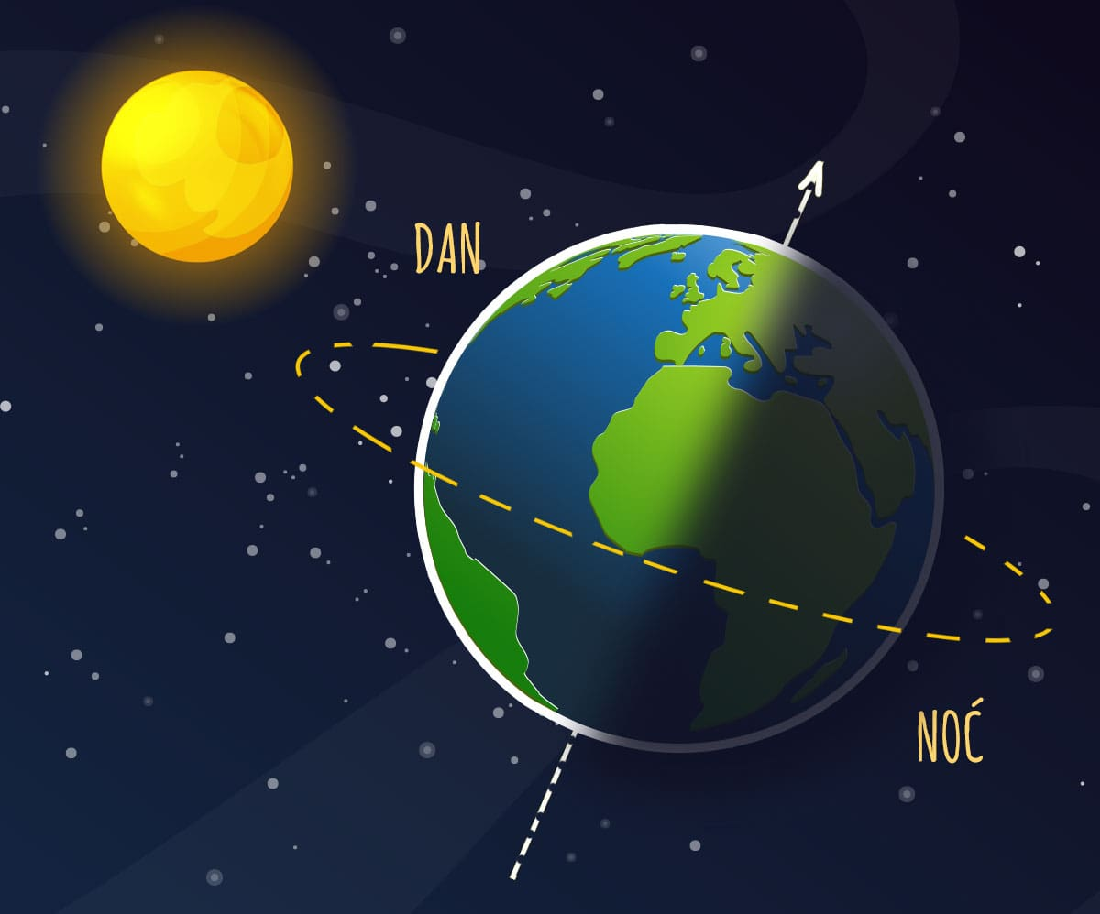
Why do day and night alternate?
DAY
NIGHT

Slide 4
MONDAY
TUESDAY
WEDNESDAY
THURSDAY
FRIDAY
SATURDAY
SUNDAY
Every Sunday I go for a walk.

Slide 5
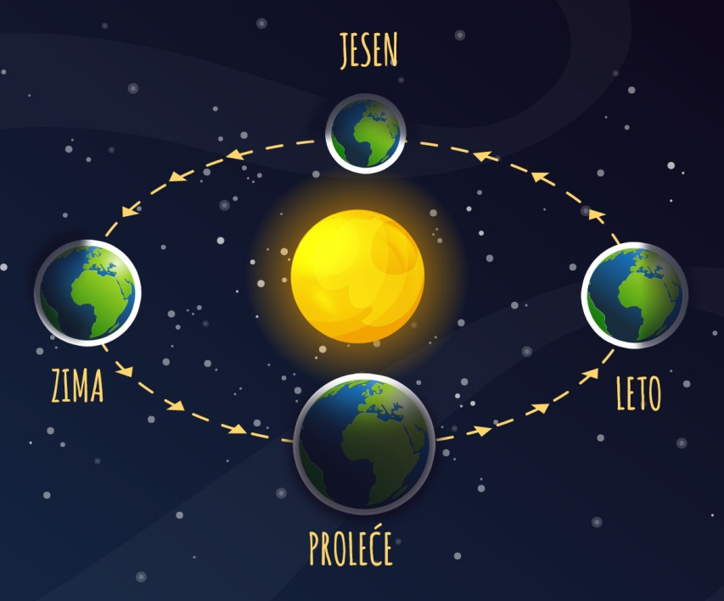
Why is it sometimes cold and sometimes warm?
AUTUMN
WINTER
SUMMER
SPRING

Slide 6
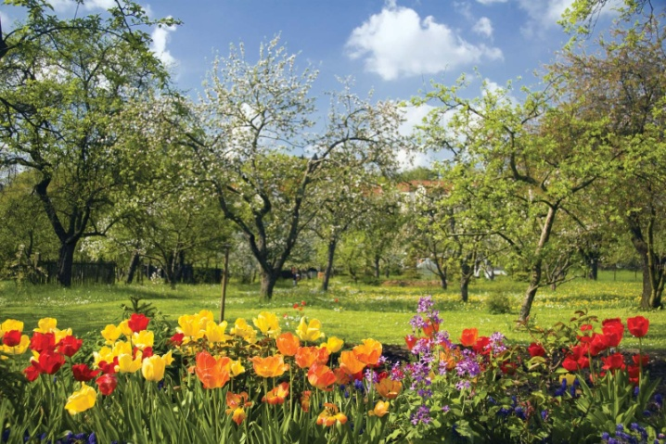
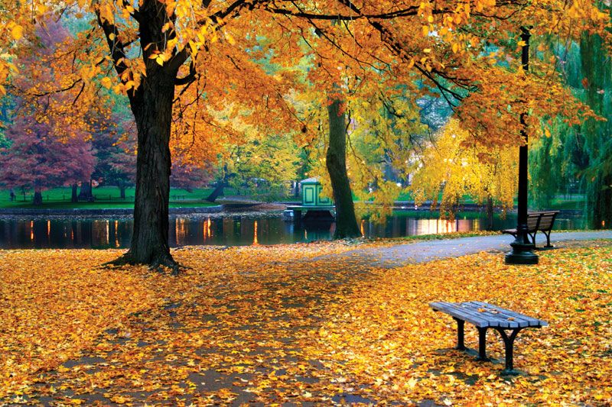
Do you like every season the same way?

Slide 7
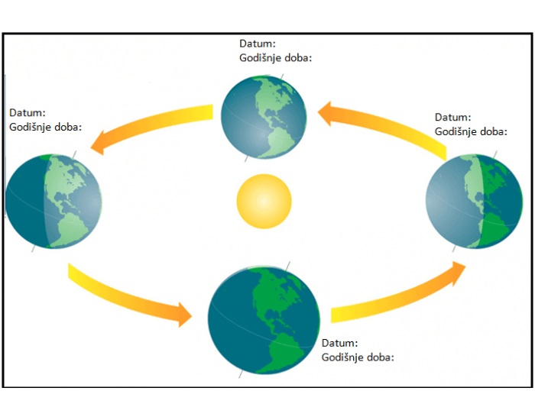
September 22nd
Autumn
December 21st
Winter
Jun 21st
Summer
March 20th
Spring

Slide 8
My calendar
Month | Picture | Date | Word
January
February
April
May
Jun
September
December
11.02.
Birthday
March
July
August
October
November

Slide 9
We are looking forward to summer and holidays!
January | February | March | April | May | Jun | July | August | September | October | November | December
Winter
Spring
Summer
Autumn

