Slide 1
Mathematical kitchen

Slide 2
Healthy Diet

Slide 3
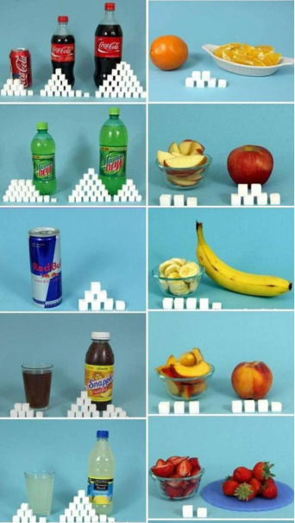

Slide 4
A HEALTHY SANDWICH?

Slide 5
How do we measure ingredients in the kitchen?
1 kg = 1000 g
1L = 1000 mL
1 glass = 240 mL
1 spoon (tablespoon) = 18 g = 18 mL
1 teaspoon (coffee) = 6 g = 6 mL

Slide 6
Task 1
Lemonade with honey for the whole class
For seven children, the recipe for lemonade is - add 130 g of honey and 225 mL of squeezed lemon juice to 1 L of water.
How much lemonade should you make for the whole class?
How much water, honey and squeezed lemon juice do we need?

Slide 7
Task 2
How much money do we need in order to buy all the ingredients needed for lemonade for the whole class?
1 kg of honey = 1200 RSD
1 kg of lemon = 200 RSD (10 lemons goes in a 1 kg of lemons)

Slide 8
Task 3
How much exercise do we need to do in order to “burn“ calories we took with lemonade?
1 glass of lemonade has 32 mL of lemon juice + 18 g of honey
32 mLof lemon juice = 7 calories
18 g of honey = 55 calories
100 squats = “burn“ 32 calories
100 lunges = “burn“ 30 calories
100 crunches = “burn“ 15 calories
And how much should we exercise if we drank a glass of Coca-Cola or ate a 100 g chocolate bar?
1 glass of coke = 100 calories
100g of chocolate = 550 calories

Slide 9
Thanks for your time

