Slide 1
Musical fractions
Teacher Ljubica lost in her thoughts enters the classroom and hums to herself Orf's composition O Fortuna.
Peter, the class clown, and a big fan of rock music looks at the teacher with interest and slowly starts tapping on the table following the rhythm.
The teacher smiles at Peter as she places the books on the desk and greets the class.

Slide 2
Teacher Ljubica: Good afternoon, children! Petar, congratulations, you caught the rhythm perfectly.
Peter (satisfied): I know what you were humming! Carmin!
Teacher (with a growing smile): You are very close. Carmina Burana. Actually, a song called O Fortuna. Composed by Karl Orff, but you'll learn about that when you're a little bit older.
Peter: It's not easy to follow that rhythm, it goes at a steady speed for a while, then it gets slower...

Slide 3
Teacher: Right. You made a good point. Kids, do you remember that last year we learned about note durations?
A weak, unconvincing yeeees comes from the classroom.
Teacher: Good, so it's time to repeat it. It fits perfectly with today's topic in mathematics.
Peter (in a panic): Mathematics!?! How?! Why math?! I love music, but math....it will ruin everything.
The teacher (now laughing a lot): Oh, Peter, Peter,
music is mathematics!

Slide 4
Let’s play!
(see activities 2 and 3)

Slide 5
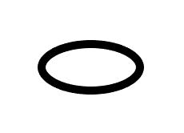
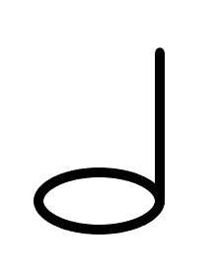
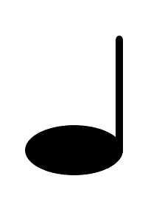
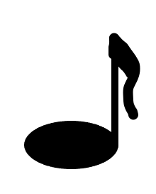
https://scratch.mit.edu/projects/698228423/fullscreen/

Slide 6
Teacher (now slightly overwhelmed by all that noise): This was a wonderful noise! Perfect! Just so you know, you played pure math!
Peter (completely sure of himself): Of course not.
Teacher: Let me convince you that you did. Let's start with the whole note. You noticed her name - whole. Do you agree that, because it is a whole, I should assign the whole number 1 to it, exactly 1?
Peter (suspiciously): Good...
Teacher: Now tell me one important thing. While Peter plays one whole note, how many of these halves can Nina play?

Slide 7
Nina (Peter's best friend and, unlike him, a big fan of math): I'm always in favor of experimental verification, but I think I know the answer right away. Those two notes with the neck. That Peter's whole note lasts four beats, and this one of mine lasts only two, so I can manage to play two while Peter stretches out that one. Am I right?
Teacher: You are. That's right. That's why your note is called half. Do you know how to write that?

Slide 8
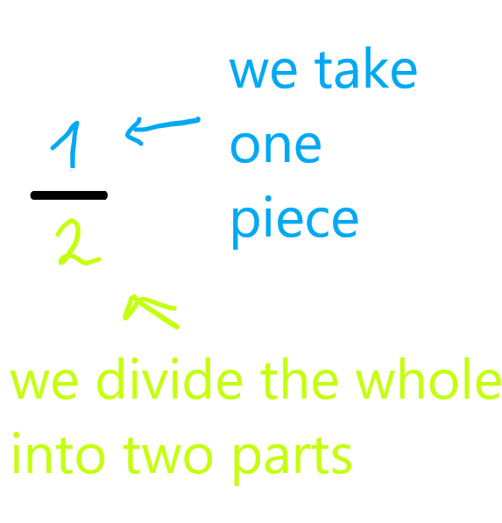
It's a fraction. That is our topic today. The dash is called the fractional line, and the number two below it tells us that we have divided our whole into two equal parts. The one above the line tells us that we took only one of those two equal parts.
We call the number above the line the numerator because it counts how many pieces we take, and the number below the line is the denominator because it tells us in how many pieces, we must divide our whole.

Slide 9
Whole note
1

Slide 10
Half note

Slide 11
Quarter note

Slide 12
Petar: Understood! This means that for a quarter below that line, the number should be four! The whole note is four beats, and for a quarter we need only one, so we divide the whole note into four parts and take only one of them.
Teacher: Well done! Just pay attention that we are dividing the whole note into four equal parts.
Nina: And if we play three of those black notes with the neck, does that mean we took three pieces of the whole note?
Teacher: That's right.
Nina: I think I know how to write it down

Slide 13
Nina: And to me, the most beautiful note is the one with a small tail.
Petar (very officially): It's not a small tail, it is a flag on a flagpole.
Nina (slightly offended, grumbles): If it looks like a tail, it is a tail...
Teacher: Please don't argue. It is called a flag. And it is not a flagpole, but a stem... That pretty picture marks the one-eighth duration. Can someone explain to me what that means?
Nina and Patar in unison: We split the whole note into eight parts and take one!
Teacher (satisfied): You understood everything. And we write:

Slide 14
Eighth note

Slide 16
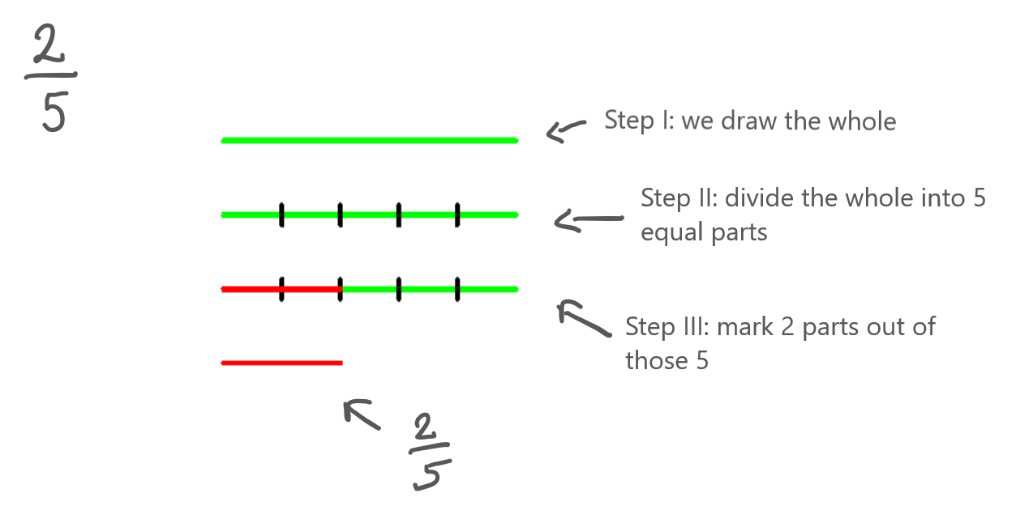

Slide 17
Nina: Of course! One quarter is less than three quarters! For that one quarter, we took only one piece after splitting, and for three quarters as many as three such pieces!

Slide 18
Petra (excitedly, interrupting Nina): And the second one makes sense too! Well, a half note is longer than a quarter note, we play it longer! And if we take three longer pieces, it must be bigger than three shorter pieces! And I noticed something else! The higher the number below the line, the smaller the pieces!

Slide 21
Petra (very cheerfully): Well, this is great! Next time my parents scold me for listening to music too loud I can tell them I'm practicing fractions! ☺

