Slide 1
HISTOTYMATHICS
Petra (the classroom Mr. Grumble, going through a book from History and grumbling to himself): Alas, years, names, years, names, and more years and years... this is going to be a very tiring lesson.
Sofia (Petra's best friend, and as it usually happens, the most cheerful person in the class, they have been sharing a desk since the second grade): Don't grumble, it's not that bad. At least it makes some sense, we're talking about people and events. Not like your favourite math where they pester us with numbers for no reason. Add them up, subtract them, then find x, as it always gets lost...ugh. Well, that's hard.

Slide 2
Petra and Sofia are so engrossed in criticizing the curriculum that they don't notice teacher Peter standing above them and smiling.
Teacher Peter: Actually, you are both right. Let's try to combine the most fun parts of both subjects and make a new one.
Sofia (brightly): Yes! And let it be called Historymathics!
Petra (with a grunt): Yes, yes, the fun parts... as long as it doesn't turn out the other way around...

Slide 3
Teacher Peter: Let us choose some interesting people from the past.
Petra: And does it have to be someone who lived a very, very long time ago? Because I have a name too! Maryam Mirzakhani! She is the first woman recipient of the Fields Medal. It is …
Teacher Peter: I know, something like the Nobel Prize for mathematics, right? We can put her on the list too.
Sofia: When it comes to choosing, I want Amelia Earhart! She was fearless!
Teacher Peter (with a smile): Agreed!

Slide 4
 | Year of birth | Year of death | Century (vs. year of birth) | Achievements
Christopher Columbus
Leonardo da Vinci
Galileo Galilei
Isaac Newton
Andres Celsius
Charles Darwin
Thomas Edison
Nikola Tesla
Marie Curie
Albert Einstein
Alexander Fleming
Amelia Earhart
Maryam Mirzakhani

Slide 5
Teacher Peter: A really colorful company. Let's place them in the appropriate time period. Let's see who lived in which century.
Do you remember what a century is?
A period of 100 years.
The first century begins in the 1st year and ends exactly in the 100th year, the 101st year is the beginning of the 2nd century, and the last year of the 2nd century is the 200th, and so on.

Slide 8
Teacher Peter: Now imagine that they all found the Philosopher's Stone and learned how to make the Elixir of Life (We all read the first Harry Potter book, right?).
1. How many candles on the cake would each of them have this year? How many candles is that in total?
2. How old would Leonardo have been the year Amelia was born?
3. Let's assume that the year is 1921 and that Alexander, Albert, Nikola, Thomas, Marie, and Amelia met. Calculate the following: we multiply the difference in the ages of Albert and Alexander by the ages of Marie, and then add the product of the years of Nikola and Thomas, and Amelia.
4. How much older is Galileo than Isaac?
5. How old would Christopher be in the first year of the 17th century? And how much in the last years of the 20th century?
6. If Charles had met Maryam in the first year of the 21st century, how many years would they have together?
7. What year would Andres celebrate his 342nd birthday? In what century?

Slide 9
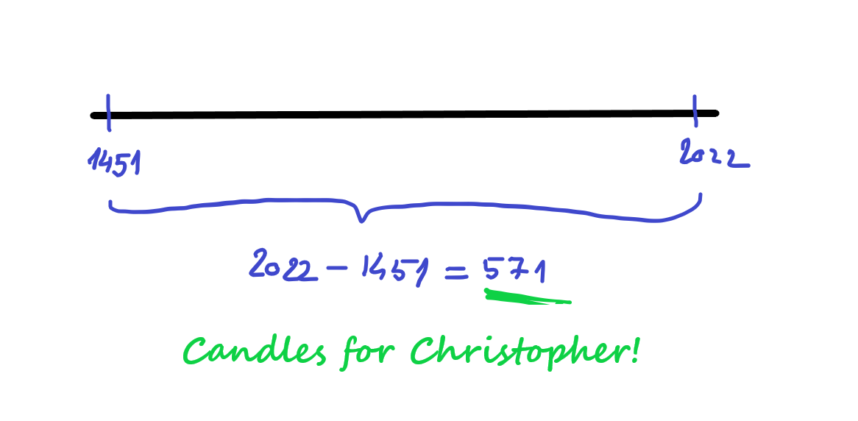
We can draw the answers!
Here is the number of candles for Christopher:

