Slide 1
Lazy dot
The physical education class is in progress, the children are warming up by throwing the ball into the basket, and the twins Anđa and Ines are arguing. First quietly, then louder and louder.
Anđa (throws a ball that bounces off the hoop and hits Ines): Well, it's easy for you, you're 137 tall, and I'm only 1.37. Of course, it's easier for you to get the ball through the hoop!
Ines (doesn't even look at her sister, but nonchalantly picks up the ball and it goes effortlessly through the hoop): What are you talking about?! We are of the same height, only you are a lost case when it comes to basketball!
Anđa (now very angry): Well, no, you have the full 137, and I barely have 1 and a little more, you know very well that the doctor at our checkup dictated that to a nurse...

Slide 2
Teacher Vlada has been watching this exchange of sparks from a safe distance for some time, but now he simply must intervene.
Vlada: Just a moment you two, how tall are you?
Anđa and Ines (at the same time): 137 centimeters/1.37 meters!
Vlada: Yes, I see where the problem is. You two were sleeping during the lesson on how we measure length!
Anđa and Ines (this time in unison): We weren’t, we really weren’t! We measure the length in meters, decimeters, centimeters, and millimeters. But meters are the main thing!

Slide 3
Anđa: But what does our height have to do with length... wait a minute, yes, our height is actually just length going up!
Ines: That's right! And your 1 and something else is in meters, and my 137 are centimeters! That's what that doctor said!
Anđa: But I still don't understand. Well, 100cm is 1m, and 10dm is the same as 1m, we learned that in class (see, we were not sleeping during the lesson), but what should we do with 137cm?
Vlada: Excellent question! It's just in time for math class, so we can clear that up.
Anđa and Ines (again in unison): No, not mathematics! It's really nice for us here in the schoolyard, at PE class.

Slide 4
Vlada: Don't worry, we're staying outside. Bear with me for a moment while I explain what decimal notation is.
As you said, when we talk about length, meters are important and it's really convenient when something is one meter or 3 meters, or 15 meters long. But, you must have noticed, it is not always like that. Look at this basketball hoop. It is at a height (as Anđa nicely explained, the length that goes up) that is greater than 2m and less than 3m. We have 2 meters and another piece that is less than a meter. If what is written on the basketball hoop is correct, we have 60 cm more. When we write down our number, we separate that part from whole meters with a dot. This dot is called a decimal point, and writing a number down with this decimal point, we get a decimal record. Now, for our basketball hoop, the part with the whole number of meters is easy, but we need to write down precisely the part that we have left. Here's an example.

Slide 5
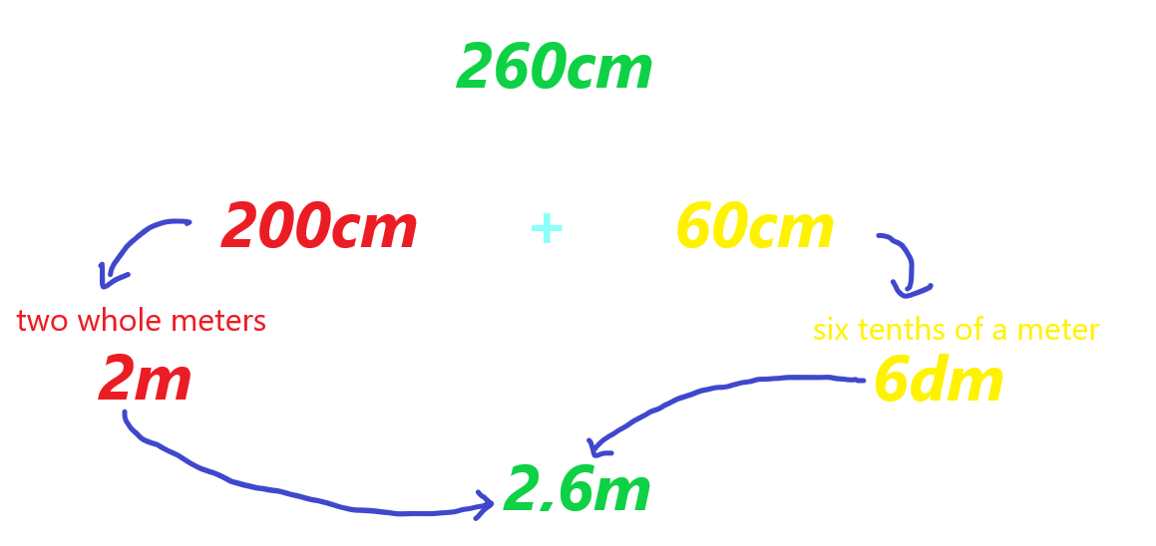
Vlada draws with chalk on the ground. Fortunately, rain is forecast for the afternoon, so everything will wash away, and the headmistress of the school will not scold them.

Slide 6
Ines: Okay, I got this. But that example had a nice 6 tenths (here, I listened in the last class, I know that when we divide a meter into ten equal parts, each part is a decimeter), but what should we do with my extra 37 cm?
Vlada: You made an excellent point. In that 37 cm, you have 3 complete decimeters and another 7 centimeters extra.
Anđa (excitedly interrupts Vlada): I listened in class too! A centimeter is a hundredth part of our meter, so we have 3 tenths and another 7 hundredths, and that's how my height turns out to be 1.37!
.

Slide 7
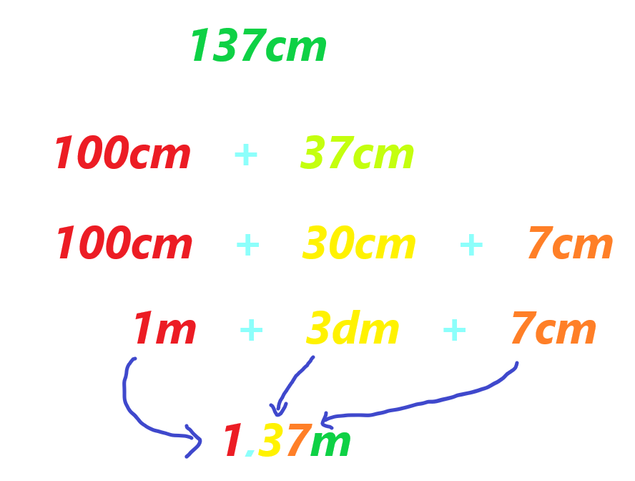
Vlada: Exactly! The first digit after the decimal point tells us how many tenths of a whole, we have, and the second digit tells how many hundredths are left. Let’s analyze your height:

Slide 8
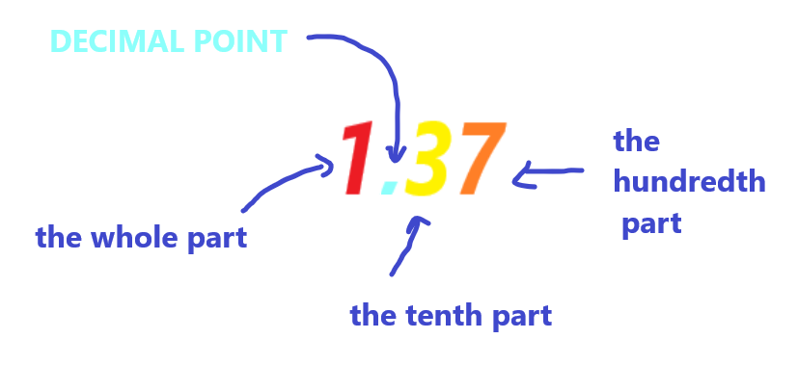
Vlada: Let's repeat what is what, and it's time to play.

Slide 9
And now it is time for the schoolyard! ☺

