Slide 2
UUU
CUA
CCC
UUG
UCU
CCA
UUC
CUG
UUA
UCC
CCU
CCG

Slide 3
UCA
UAC
UGU
UGG
UCG
UAA
UGC
CUU
UAU
UAG
UGA
CUC

Slide 4
CAU
CAG
CGG
AUA
CAC
CGU
AUU
AUG
CAA
CGC
AUC
ACU

Slide 5
ACC
AAU
AAG
AGA
ACA
AAC
AGG
AGU
ACG
AAA
AGC
GUU

Slide 6
GUC
GCU
GCG
GAA
GUA
GCC
GAU
GAG
GUG
GCA
GAC
GGU

Slide 7
GGC
CGA
GGA
GGG

Slide 8
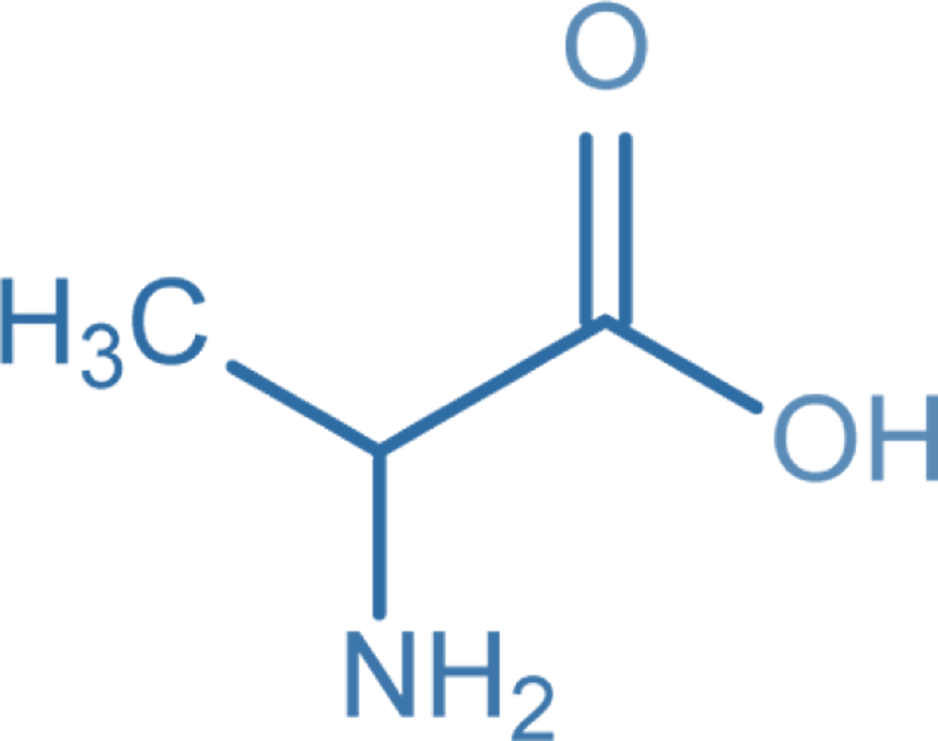
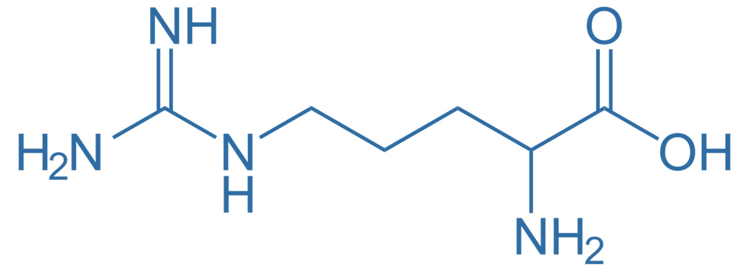
Ala
Ala
Ala
Ala
Arg
Arg
CGA
CGG
CGU
CGC
GCA
GCG

Slide 9
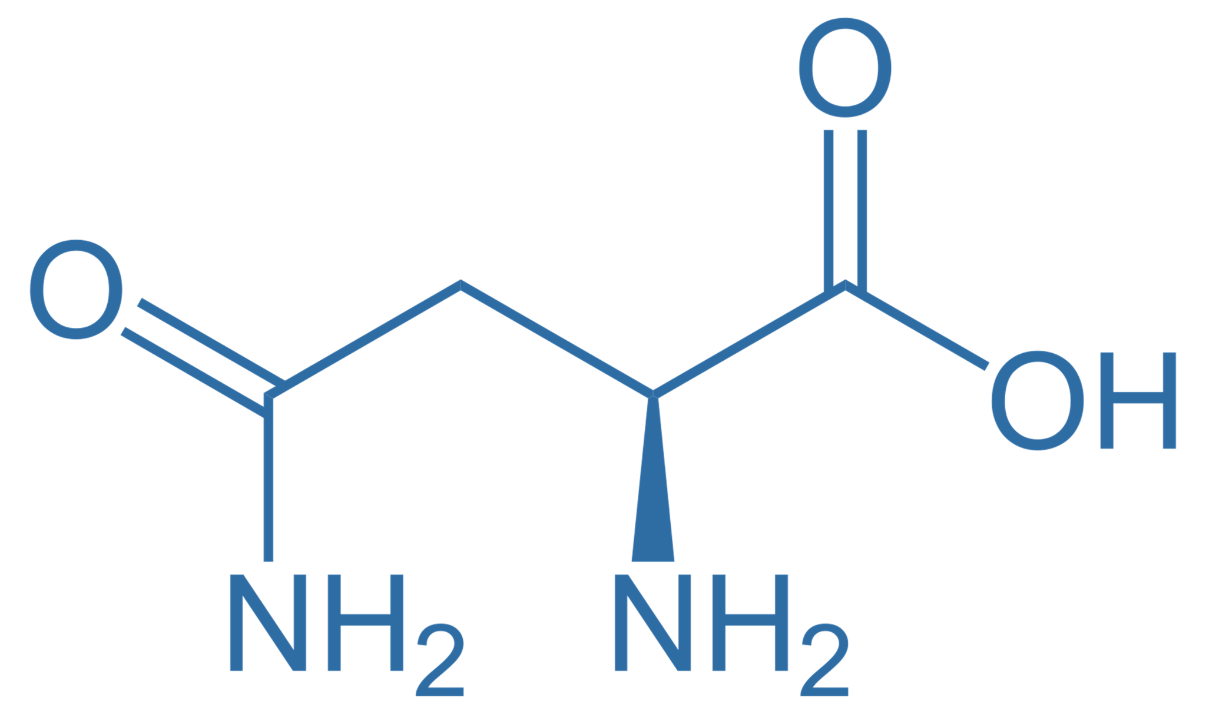
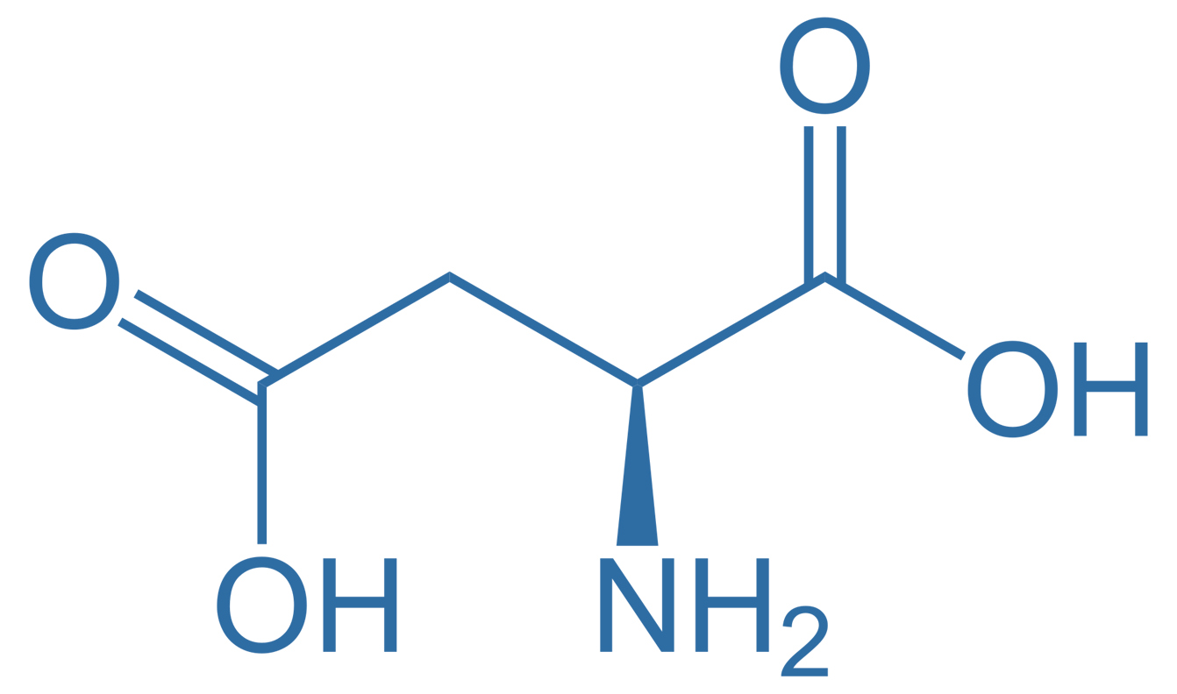
Arg
Arg
Asn
Asn
Asp
Asp
GCU
GCG
UUA
UUG
CUA
CUG

Slide 10
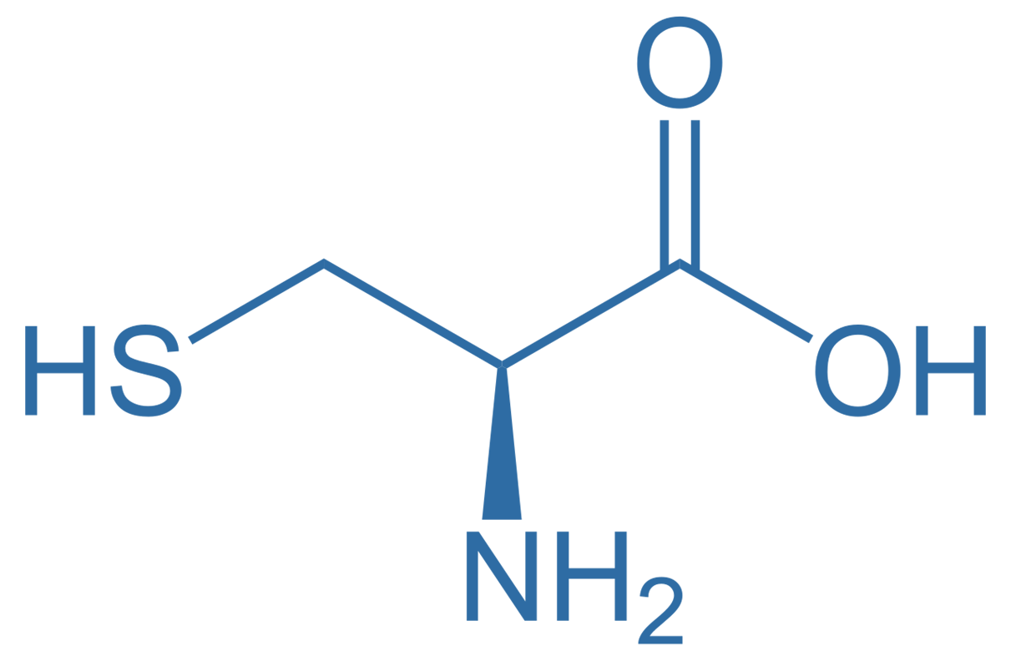
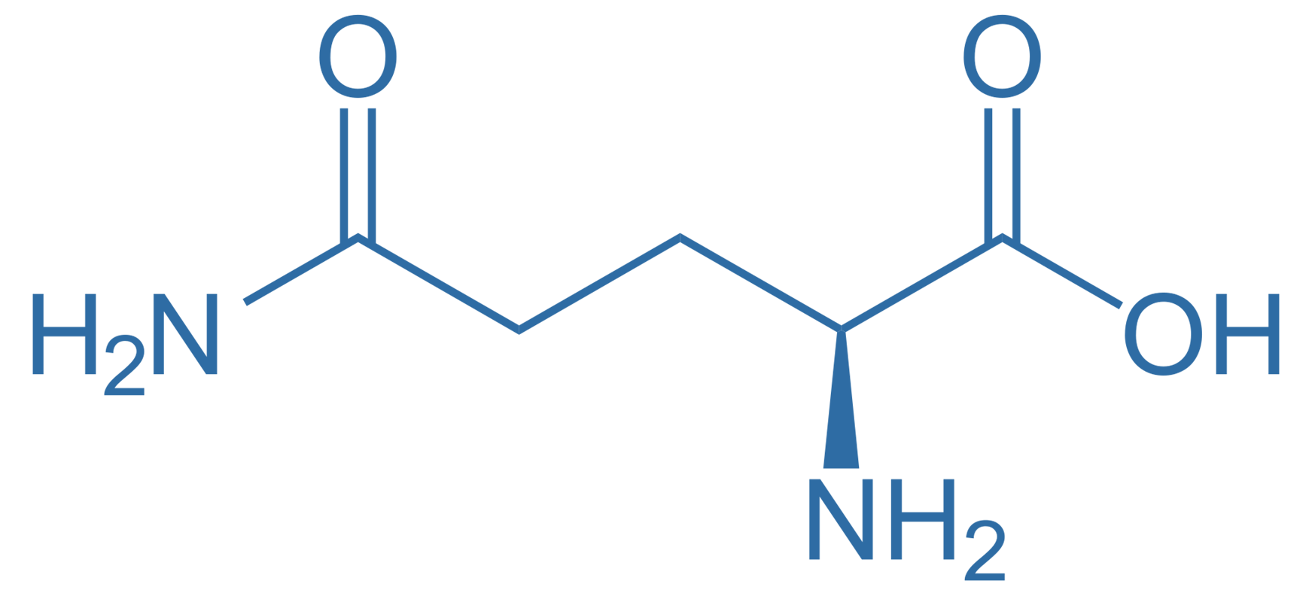
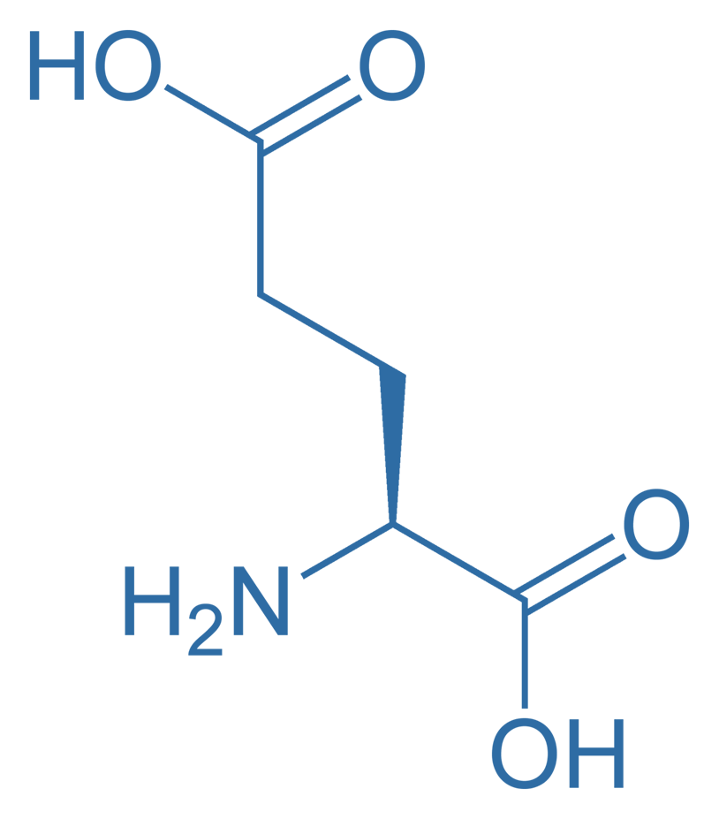
Cys
Cys
Gln
Gln
Glu
Glu
ACA
ACG
GUU
GUC
CUU
CUG

Slide 11
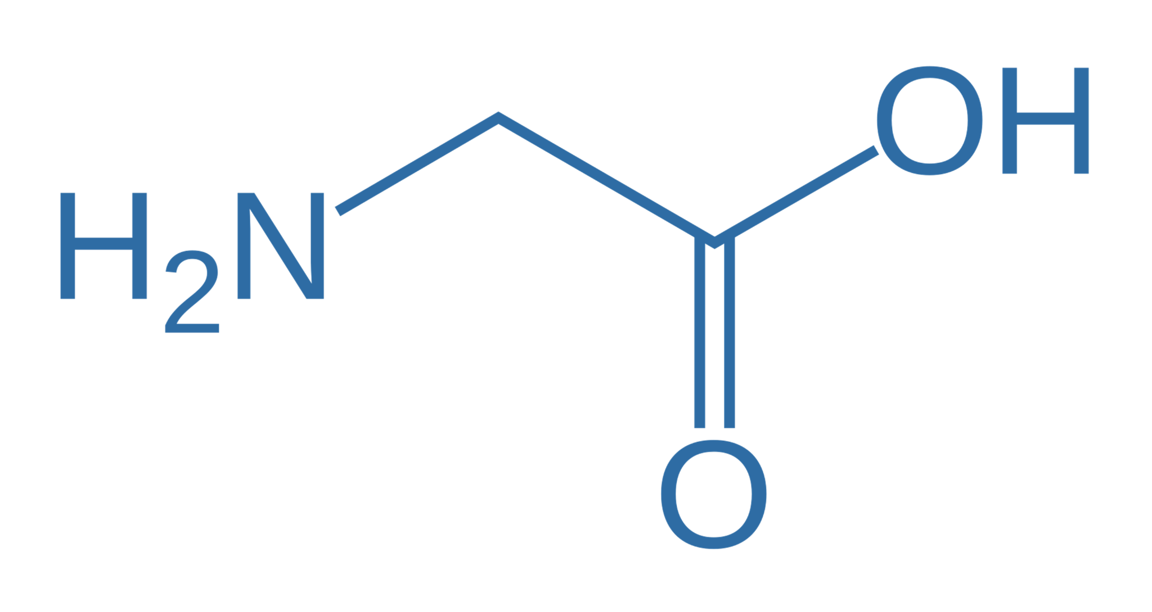
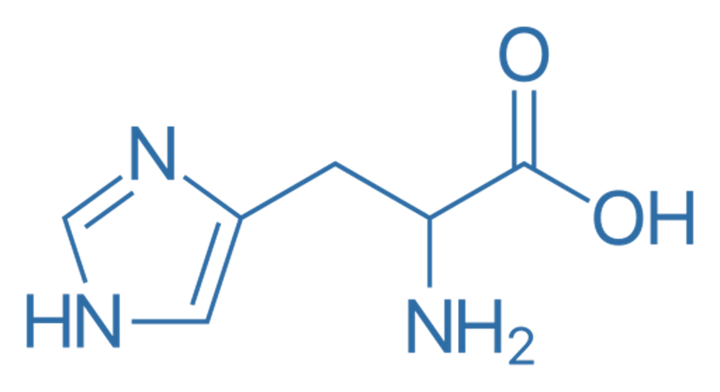
Gly
Gly
Gly
Gly
His
His
CCA
CCG
CCA
CCG
GUA
GUG

Slide 12
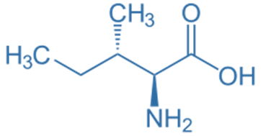
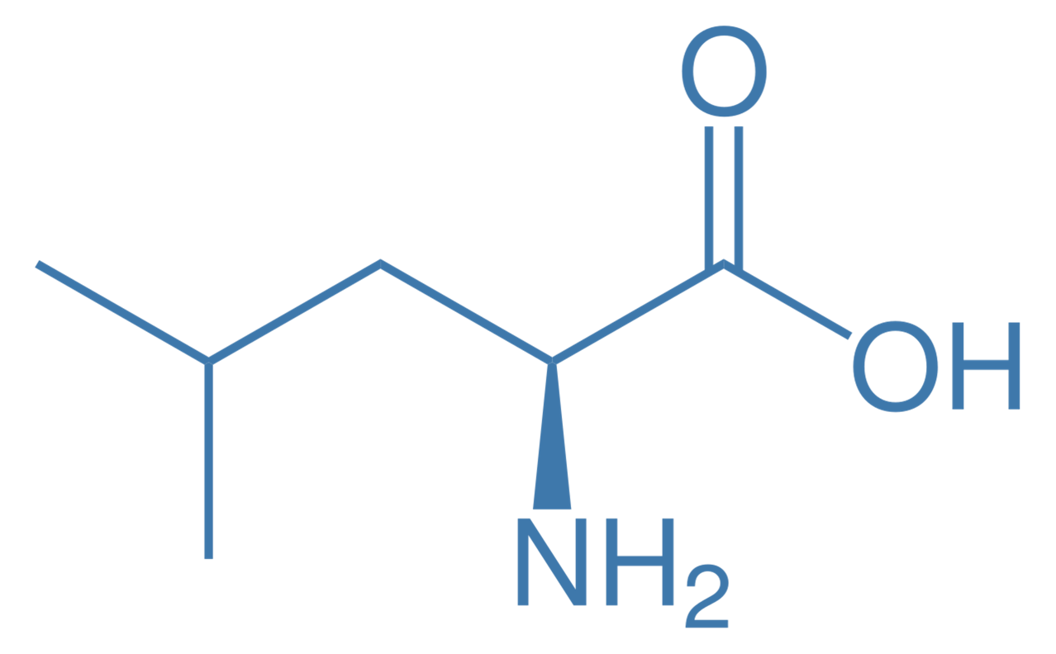
Ile
Ile
Ile
Leu
Leu
Leu
UAA
UAG
UAC
GAA
GAG
GCA

Slide 13
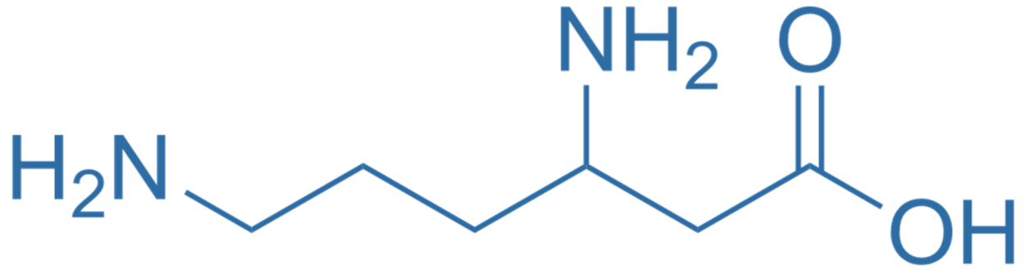
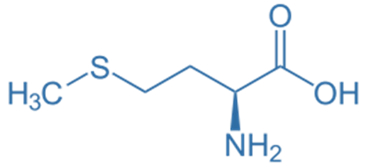
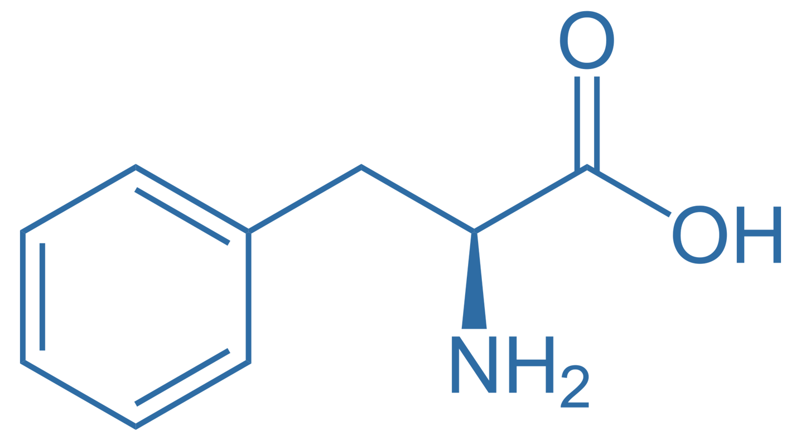
Leu
Lys
Lys
Met
Phe
Phe
GCG
UUU
UUA
UAC
AAA
AAG

Slide 14
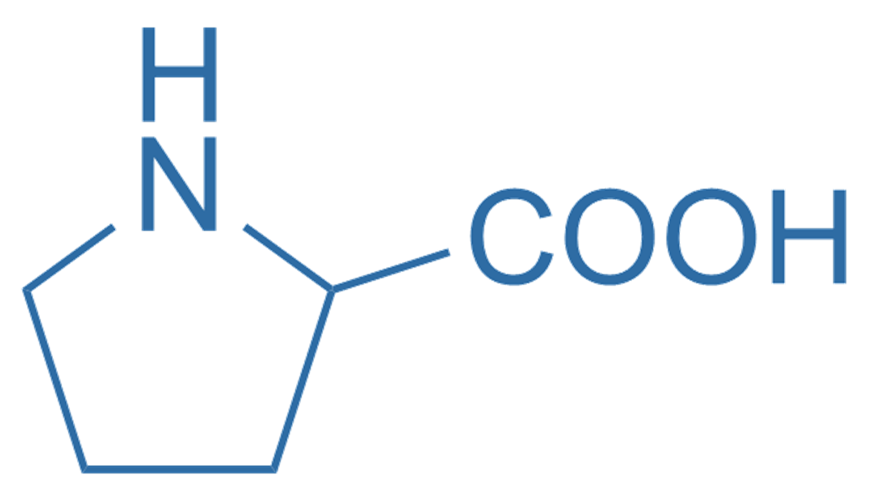
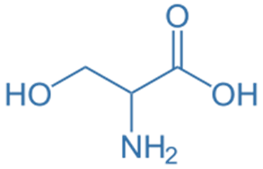
Pro
Pro
Pro
Pro
Ser
Ser
GGA
GGG
GGU
GGC
AGA
AGG

Slide 15
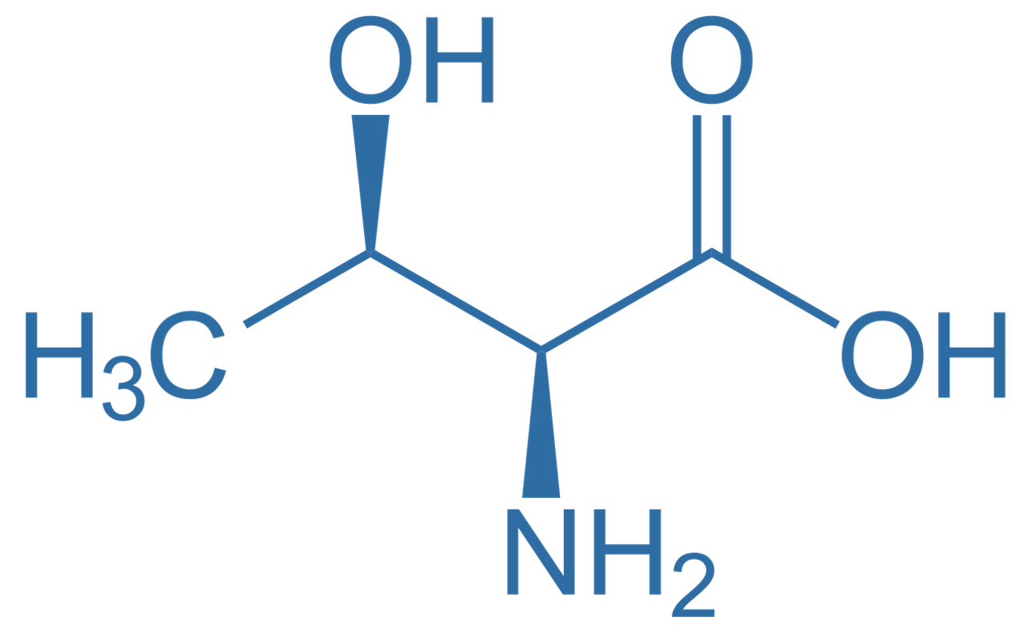
Ser
Ser
Thr
Thr
Thr
Thr
AGU
AGC
UGA
UGG
UGC
UGU

Slide 16
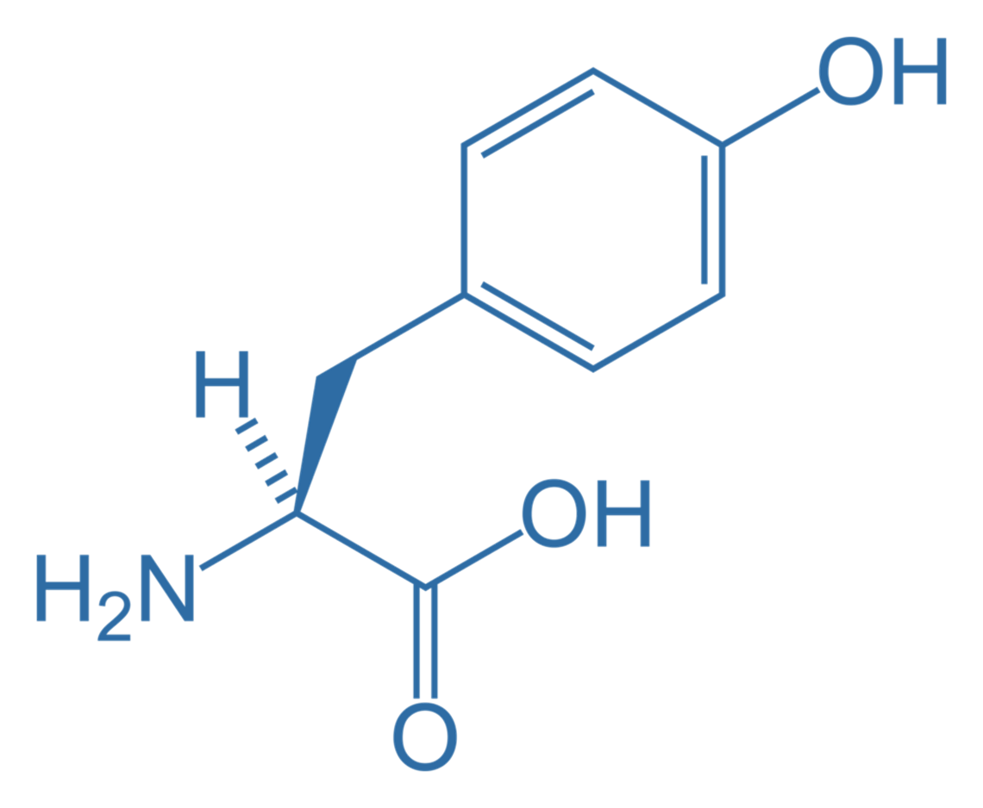
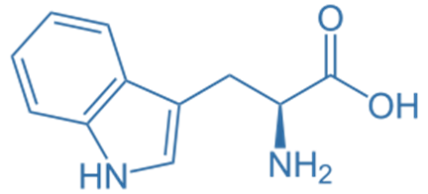
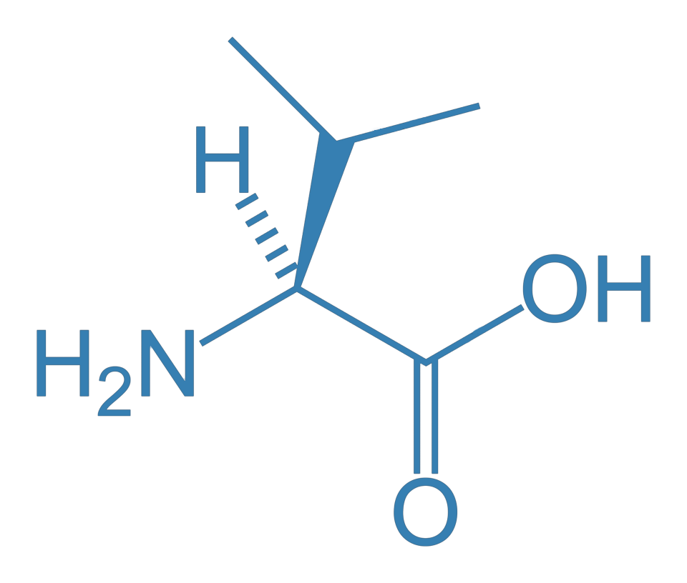
Trp
Tyr
Tyr
Val
Val
Val
ACC
AUA
AUG
CAA
CAG
CCG

Slide 17
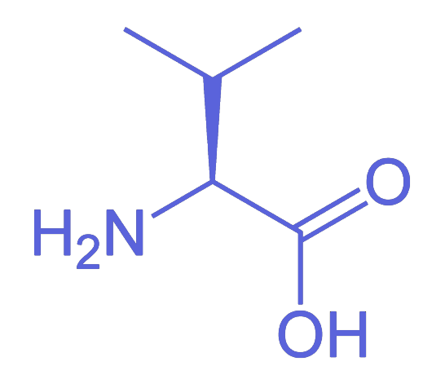
Val
CCG

Slide 18


Slide 29


