Slide 1

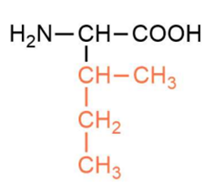
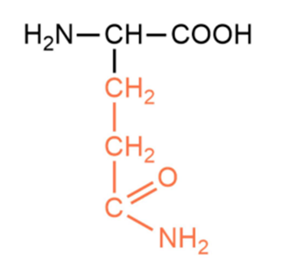
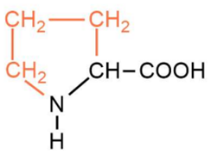

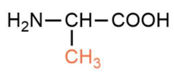

GLYCINE
  non-essential, non-polar
  participates in collagen synthesis, found in protein bends of both animal and plant origin
  sources include red meat, fish, eggs, red beans
ALANINE
  non-essential, non-polar
  involved in glucose and amino acid metabolism, β-alanine is used in sports supplementation
  sources include turkey, chicken, almonds, dairy products
PROLINE
  non-essential, non-polar
  highly concentrated in collagen, contributes to wound healing and tissue/skin elasticity
  sources include eggs, meat, dairy products
ISOLEUCINE
  essential, non-polar
  involved in building muscle tissue, helps regulate blood sugar levels
  sources include eggs, tuna, legumes, nuts, cereals
GLUTAMINE
  essential, polar
  acts as a buffer in the kidneys (maintains body pH) and supports muscle recovery
  sources include meat, fish, eggs, dairy products, legumes

Slide 2
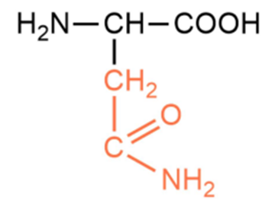
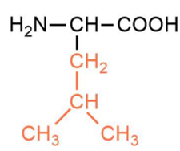
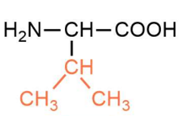
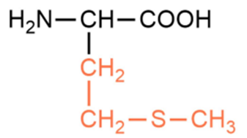
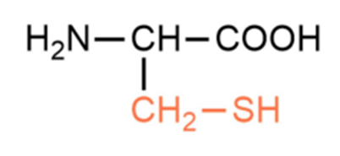
ASPARAGINE
non-essential, polar
precursor of the neurotransmitter aspartate, heat-sensitive
sources include asparagus, potatoes, meat, dairy products
VALINE
  essential, non-polar
  provides energy to muscles, aids in tissue regeneration, supports neurological functions
  sources include fish, turkey and chicken meat, lentils, peanuts
LEUCINE
  essential, non-polar
  stimulates protein synthesis in muscles, accelerates post-training recovery, influences insulin secretion
  sources include meat, dairy products, eggs, legumes
CYSTEINE
  essential, polar
  important for glutathione synthesis, component of keratin, used in cosmetics, pharmaceuticals, supplements, and like an antioxidant
  sources include egg yolks, meat, garlic, onions, broccoli
METHIONINE
  essential, non-polar
  initiates protein synthesis, added to animal feed, used as a dietary supplement
  sources include meat, fish, dairy products, eggs, cereals

Slide 3
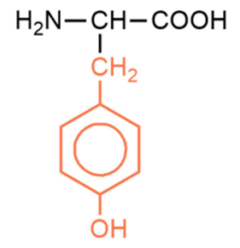
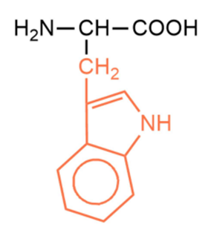
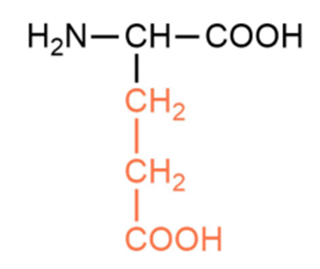
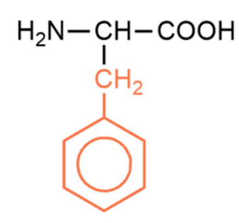
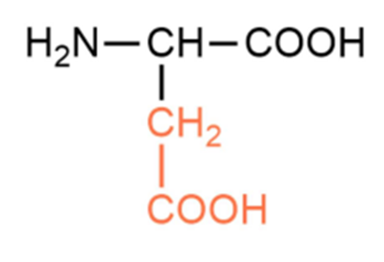
ASPARTIC ACID
  non-essential, polar
  participates in the Krebs cycle and in the synthesis of other amino acids and urea, component of collagen, acts as a neurotransmitter
  sources include cereals, avocado, sugarcane, asparagus
GLUTAMIC ACID
  non-essential, polar
  important in nitrogen metabolism and protein synthesis, acts as a neurotransmitte, glutamate is used as a flavor enhancer
  sources include meat, poultry, fish, dairy products
PHENYL
ALANINE
  essential, non-polar
  plays a key role in tissue building and enzyme synthesis, precursor for tyrosine, which further leads to production of dopamine, adrenaline, and noradrenaline
  sources include meat, nuts, eggs, fish
TYROSINE
  non-essential, polar
  plays an important role in the synthesis of thyroxine and melanin, acts as a neurotransmitter, used to improve concentration and mental alertness
  sources include soy products, nuts, avocado, cheese
TRYPTOPHAN
  essential, non-polar
  precursor for the synthesis of serotonin (the “happiness hormone”), melatonin (the “sleep hormone”), and niacin (vitamin B3)
  sources include turkey, chicken, fish, eggs, dairy products, pumpkin seeds

Slide 4
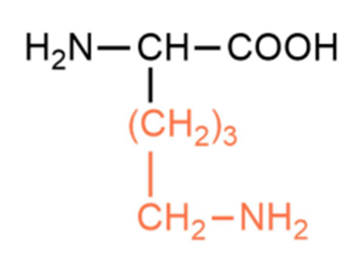
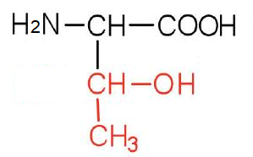
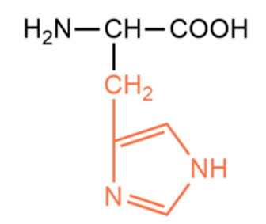
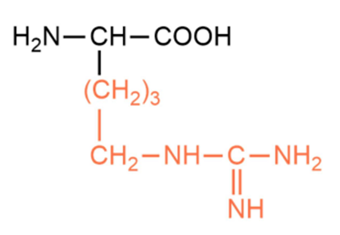
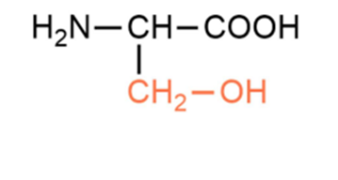
LYSINE
  essential, polar
  participates in the formation of histones and cross-links in collagen, aids calcium absorption, strengthens the immune system
  sources include meat, eggs, dairy products
SERINE
  non-essential, polar
  plays a role in protein and phospholipid synthesis, precursor for other amino acids, integral part of active sites in many enzymes, involved in phosphorylation
  sources include turkey, peanuts, soy
THREONINE
  non-essential, polar
  essential for protein synthesis, fat metabolism in the liver, synthesis of antibodies and immunoglobulins (immune function), crucial for tissue growth and regeneration
  sources include meat, fish, eggs
HISTIDINE
  essential, polar
  participates in the synthesis of structural proteins, precursor of histamine, important for immunity, regulation of sleep, appetite, and alertness, has antioxidant effects
  sources include, meat bananas, milk
ARGININE
  essential, polar
  improves circulation, aids wound healing, supports muscle growth, strengthens the immune system
  sources include meat, fish, dairy products, eggs, pumpkin seeds

Slide 5


