Slide 1

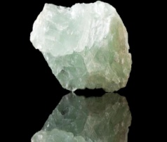
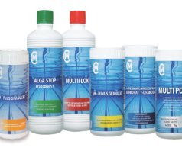
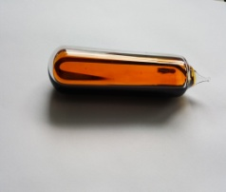
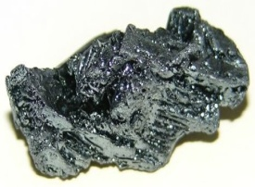


9
F
17
35
53
2
Cl
Br
I
He
18,9
35,4
79,9
126,9
4
FLUORINE
CHLORINE
BROMINE
IODINE
HELIUM
(FLUORES)
(CHLORIUM)
(BROMIUM)
(IODUM)
(HELIUM)
USAGE:
USAGE:
USAGE:
USAGE:
USAGE:
-AIR CONDITIONERS
-MEDICINES
-POLYMERS
-WATER DISINFECTION
-POOL DISINECTION
-CHEMICAL PRODUCTION
-DISINFECTANT
- REAGENT
- SEDATIVE
-ANTISEPTIC
-DIETARY SUPPLEMENT
-PHOTO INDUSTRY
-BALLOON FILLING
-ZEPPELIN FILLING
-REFRIGERANT

Slide 2
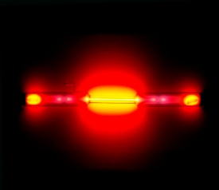
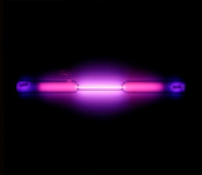
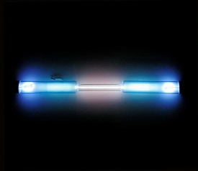
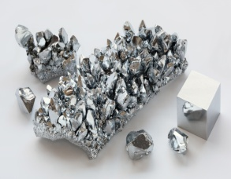
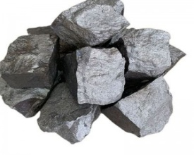
10
Ne
18
Ar
36
Kr
24
Cr
25
Mn
20,2
39,9
83,8
52
54,9
NEON
ARGON
KRYPTON
CHROMIUM
MANGANESE
(NEON)
(ARGON)
(KRYPTON)
(CHROMIUM)
(MANGANIUM)
USAGE:
USAGE:
USAGE:
USAGE:
USAGE:
-NEON LAMPS
-LASERS
-X-RAY TUBES
-INTERT GAS
-LAMP PRODUCTION
-FOOD PRESERVATION
-LAMP MANUFACTURING
-WINDOW INSULATION
-MAGNETIC RESONANCE IMAGING
-CATALYST
-ALLOY PRODUCTION
-PIGMENT (COLOR)
-CATALYST
-PIGMENT (COLOR)
-BATTERY PRODUCTION

Slide 3
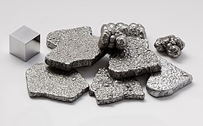
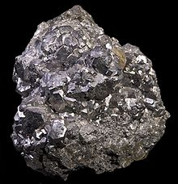
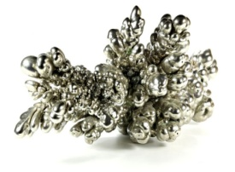
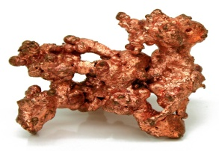
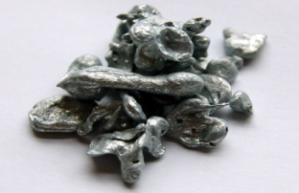
26
Fe
27
28
29
30
Co
Ni
Cu
Zn
55,8
58,9
58,7
63,5
65,4
IRON
COBALT
NICKEL
COPPER
ZINC
(FERRUM)
(COBALTUM)
(NICCOLUM)
(CUPRUM)
(ZINCUM)
USAGE:
USAGE:
USAGE:
USAGE:
USAGE:
-TOOL MANUFACTURING
-STEEL ALLOY PRODUCTION
-VEHICLE COMPONENTS MANUFACTURING
-CATALYST
-ALLOY PRODUCTION
- PIGMENT (COLOR)
-CATALYST
-ALLOY PRODUCTION
-MILITARY EQUIPMENT PRODUCTION
-WIRE PRODUCTION
-CABLE PRODUCTION
-TOOL MANUFACTURING
-ALLOY PRODUCTION
-DIETARY SUPPLEMENT
-COSMETIC INDUSTRY

Slide 4
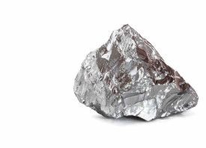
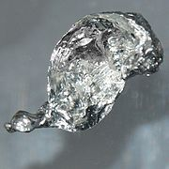
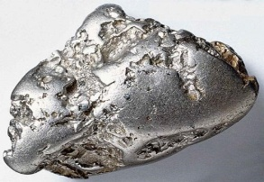
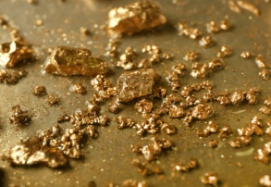
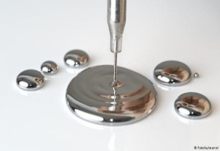
47
48
78
79
80
Ag
Cd
Pt
Au
Hg
107,9
112,4
195,1
197
200,6
SILVER
CADMIUM
PLATINUM
GOLD
MERCURY
(ARGENTUM)
(CADMIUM)
(PLATINUM)
(AURUM)
(HYDRARGYRUM)
USAGE:
USAGE:
USAGE:
USAGE:
USAGE:
-JEWELRY PRODUCTION
-COIN PRODUCTION
-CUTLERY PRODUCTION
-CATALYST
-PIGMENT (COLOR)
-BATTERY PRODUCTION
-CATALYST
-MEDICAL EQUIPMENT PRODUCTION
-JEWELRY PRODUCTION
-CATALYST
-ALLOY PRODUCTION
-JEWELRY PRODUCTION
-THERMOMETER PRODUCTION
-DENTAL EQUIPMENT
-ELECTRICAL DEVICES PRODUCTION

Slide 5


